Slide 1
Introduction to Java

Slide 2
What is Java?
It’s a popular programming language, created in 1995.
Created by James Gosling at sun microsystems
Now it’s owned by Oracle

Slide 3
Why Java?
It was is and will be “hot” language in the market.
It’s almost entirely object-oriented
It has a vast library of predefined objects and operations
It’s more platform independent
this makes it great for Web programming
It’s more secure

Slide 4
How is Java platform independent ?

Slide 5
Java Virtual Machine
Whenever we enter a statement “javac filename.java” or compile a code in java, javac compiles the code. And it creates an intermediate code called Byte Code.
Bytecode adds this important feature in Java of being independent/ portable as this bytecode is independent of the platforms. This dependency eases the tasks as it can be used in various environments with lesser planning and translation.
The .class files generated by the compiler are not executable binaries
so Java combines compilation and interpretation
Instead, they contain “byte-codes” to be executed by the Java Virtual Machine
other languages have done this, e.g. UCSD Pascal
This approach provides platform independence, and greater security

Slide 6
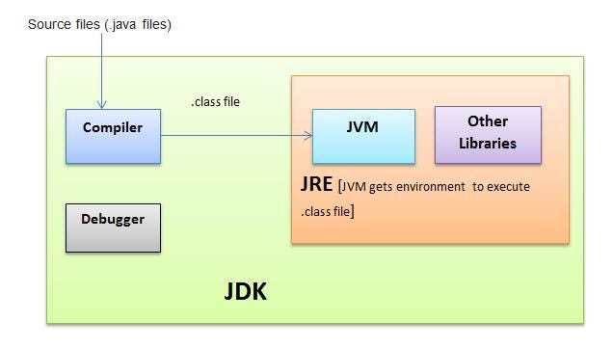
JVM: Java Virtual Machine (JVM) is an abstract computing machine. Java programs are written against the JVM specification. JVM is specific for OS platform and they translate the Java instructions to the underlying platform specific instructions and execute them. JVM enables the Java programs to be platform independent.
JRE: Java Runtime Environment (JRE) is an implementation of the JVM and Java API.
JDK: Java Development Kit (JDK) contains JRE along with various development tools like Java libraries, Java source compilers, Java debuggers, bundling and deployment tools.

Slide 7
JVM Internals
Like a real computing machine, JVM has an instruction set and manipulates various memory areas at run time. Thus for different hardware platforms one has corresponding implementation of JVM available as vendor supplied JREs. It is common to implement a programming language using a virtual machine.
A Java virtual machine instruction consists of an opcode specifying the operation to be performed, followed by zero or more operands embodying values to be operated upon. From the point of view of a compiler, the Java Virtual Machine (JVM)is just another processor with an instruction set, Java bytecode, for which code can be generated.
Life cycle is as follows,
source code -> byte code ->JVM process it->to be interpreted by the JRE and gets converted to the platform specific executable ones.

Slide 8
Just-in-time Compiler (JIT)
JIT is the part of the Java Virtual Machine (JVM) that is used to speed up the execution time. JIT compiles parts of the byte code that have similar functionality at the same time, and hence reduces the amount of time needed for compilation. Here the term “compiler” refers to a translator from the instruction set of a Java virtual machine (JVM) to the instruction set of a specific CPU.

Slide 9
Building Standalone JAVA Programs
Prepare the file foo.java using an editor
Invoke the compiler: javac foo.java
This creates foo.class
Run the java interpreter: java foo

Slide 10
HelloWorld (standalone)
public class HelloWorld {
public static void main(String[] args) {
System.out.println("Hello World!");
}
}
Note that String is built in
println is a member function for the System.out class

Slide 11
Comments in Java
/* This kind of comment can span multiple lines */
// This kind is to the end of the line
/** * This kind of comment is a special * ‘javadoc’ style comment */

Slide 12
Primitive data
Main data types are int, double, boolean, char
Also have byte, short, long, float
boolean has values true and false
Declarations look like C, for example,
double x, y;
int count = 0;

Slide 13
Logical Expressions
Assignment statements mostly look like those in C; you can use =, +=, *= etc.
Arithmetic uses the familiar + - * / %
Java also has ++ and --
Java has boolean operators && || !
Java has comparisons < <= == != >= >
Java does not have pointers or pointer arithmetic

Slide 14
Control statements
if (x < y) smaller = x;
if (x < y){ smaller=x;sum += x;} else { smaller = y; sum += y; }
while (x < y) { y = y - x; }
do { y = y - x; } while (x < y)
for (int i = 0; i < max; i++) sum += i;

Slide 15
Control statements II
switch (1) { case 0: m = n - 1; break; case 1: m = n + 1; case 3: m = m * n; break; default: m = -n; break; }

Slide 16
Setup IDE
Download JDK https://www.oracle.com/in/java/
Download the LTS(Long time support version)
After downloading select the path where your jdk is downloaded
Go to environment variables
Advances->Environment variables
Go to Path double click on it and paste the path

Slide 17
Methods in Java
A method is a block of code or collection of statements or a set of code grouped together to perform a certain task or operation. It is used to achieve the reusability of code. We write a method once and use it many times. We do not require to write code again and again. It also provides the easy modification and readability of code, just by adding or removing a chunk of code. The method is executed only when we call or invoke it.

Slide 18
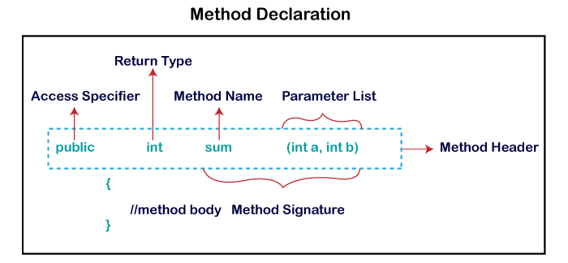

Slide 19
what is a class?
A class consists of
a collection of fields, or variables, very much like the named fields of a struct
all the operations (called methods) that can be performed on those fields, classes
can be instantiated
A class describes objects and operations defined on those objects

Slide 20
Name conventions
Java is case-sensitive; maxval, maxVal, and MaxVal are three different names
Class names begin with a capital letter
All other names begin with a lowercase letter
Subsequent words are capitalized: theBigOne
Underscores are not used in names
These are very strong conventions!

Slide 21
The class hierarchy
Classes are arranged in a hierarchy
The root, or topmost, class is Object
Every class but Object has at least one superclass
A class may have subclasses
Each class inherits all the fields and methods of its (possibly numerous) superclasses

Slide 22
An example of a class
class Person { String name; int age;
void birthday ( ) { age++; System.out.println (name + ' is now ' + age); } }

Slide 23
Another example of a class
class Driver extends Person { long driversLicenseNumber; Date expirationDate; }

Slide 24
What is Object?
A Java object is a member (also called an instance) of a Java class. Each object has an identity, a behavior and a state

Slide 25
Creating and using an object
Person john= new Person ( ); john.name = "John Smith"; john.age = 37;
Person mary = new Person ( ); mary.name = "Mary Brown"; mary.age = 33; mary.birthday ( );

Slide 26
Person mary = new Person ( );
int[] myArray = new int[5];
myArray[0]=1;
myArray[1]=4;
myArray[2]=9;
myArray[3]=16;
myArray[4]=25;
or:
int[] myArray = {1, 4, 9, 16, 25};
String[] languages= {"Prolog", "Java"};

Slide 27
Access Modifiers in Java
The access modifiers in Java specifies the accessibility or scope of a field, method, constructor, or class. We can change the access level of fields, constructors, methods, and class by applying the access modifier on it.

Slide 28
There are four types of Java access modifiers:
Private: The access level of a private modifier is only within the class. It cannot be accessed from outside the class.
Default: The access level of a default modifier is only within the package. It cannot be accessed from outside the package. If you do not specify any access level, it will be the default.
Protected: The access level of a protected modifier is within the package and outside the package through child class. If you do not make the child class, it cannot be accessed from outside the package.
Public: The access level of a public modifier is everywhere. It can be accessed from within the class, outside the class, within the package and outside the package.
There are many non-access modifiers, such as static, abstract, synchronized, native, volatile, transient, etc. Here, we are going to learn the access modifiers only.

Slide 29
What are constructors
A constructor in Java is a special method that is used to initialize objects. The constructor is called when an object of a class is created. It can be used to set initial values for object attributes:

Slide 30
Eg-
public class Main {
int x; // Create a class attribute
// Create a class constructor for the Main class
public Main() {//no-parameter constructor
x = 5; // Set the initial value for the class attribute x
}
public static void main(String[] args) {
Main myObj = new Main(); // Create an object of class Main (This will call the constructor)
System.out.println(myObj.x); // Print the value of x
}
}

Slide 31
public class Main {
int x;
public Main(int y) {//parametrised constructor
x = y;
}
public static void main(String[] args) {
Main myObj = new Main(5);
System.out.println(myObj.x);
}
}

Slide 32
public class Main {
int year;
String name;
public Main(int year, String name) {
this.year= year;
this.name= name;
}
public static void main(String[] args) {
Main myCar = new Main(1969, "Mustang");
System.out.println(myCar.year+ " " + myCar.name);
}

Slide 33
OOPS(Object Oriented Programming)

Slide 34
OOPs refers to languages that use objects in programming, they use objects as a primary source to implement what is to happen in the code.
Objects are seen by the viewer or user, performing tasks assigned by you.
Object-oriented programming aims to implement real-world entities like inheritance, hiding, polymorphism etc. in programming.
The main aim of OOP is to bind together the data and the functions that operate on them so that no other part of the code can access this data except that function.

Slide 35
Inheritance
Inheritance is an important pillar of OOP (Object Oriented Programming). It is the mechanism in Java by which one class is allowed to inherit the features (fields and methods) of another class. We are achieving inheritance by using extends keyword.

Slide 36
Let us discuss some frequently used important terminologies:
Superclass: The class whose features are inherited is known as superclass (also known as base or parent class).
Subclass: The class that inherits the other class is known as subclass (also known as derived or extended or child class). The subclass can add its own fields and methods in addition to the superclass fields and methods.
Reusability: Inheritance supports the concept of “reusability”, i.e. when we want to create a new class and there is already a class that includes some of the code that we want, we can derive our new class from the existing class. By doing this, we are reusing the fields and methods of the existing class.

Slide 37
class Bicycle {
// the Bicycle class has two fields
public int gear;
public int speed;
// the Bicycle class has one constructor
public Bicycle(int gear, int speed)
{
this.gear = gear;
this.speed = speed;
}
// the Bicycle class has three methods
public void applyBrake(int decrement)
{
speed -= decrement;
}
public void speedUp(int increment)
{
speed += increment;
}
// toString() method to print info of Bicycle
public String toString()
{
return ("No of gears are " + gear + "\n"
+ "speed of bicycle is " + speed);
}
}
// derived class
class MountainBike extends Bicycle {
// the MountainBike subclass adds one more field
public int seatHeight;
// the MountainBike subclass has one constructor
public MountainBike(int gear, int speed,
int startHeight)
{
// invoking base-class(Bicycle) constructor
super(gear, speed);
seatHeight = startHeight;
}
// the MountainBike subclass adds one more method
public void setHeight(int newValue)
{
seatHeight = newValue;
}
// overriding toString() method
// of Bicycle to print more info
@Override public String toString()
{
return (super.toString() + "\nseat height is "
+ seatHeight);
}
}
// driver class
public class Test {
public static void main(String args[])
{
MountainBike mb = new MountainBike(3, 100, 25);
System.out.println(mb.toString());
}
}

Slide 38
class Employee {
int salary = 60000;
}
// Inherited or Sub Class
class Engineer extends Employee {
int benefits = 10000;
}
// Driver Class
class Gfg {
public static void main(String args[])
{
Engineer E1 = new Engineer();
System.out.println("Salary : " + E1.salary
+ "\nBenefits : " + E1.benefits);
}
}

Slide 39
Types of inheritance
Single inheritance
Multilevel inheritance
Hierarchical inheritance
Multiple inheritance of class not possible

Slide 40
2. Abstraction
Abstraction is a process of hiding the implementation details and showing only functionality to the user.
or
Data Abstraction may also be defined as the process of identifying only the required characteristics of an object, ignoring the irrelevant details. The properties and behaviors of an object differentiate it from other objects of similar type and also help in classifying/grouping the object.

Slide 41
Eg.-
Consider a real-life example of a man driving a car. The man only knows that pressing the accelerators will increase the car speed or applying brakes will stop the car, but he does not know how on pressing the accelerator, the speed is actually increasing. He does not know about the inner mechanism of the car or the implementation of the accelerators, brakes etc. in the car. This is what abstraction is.

Slide 42
Ways to achieve Abstraction
There are two ways to achieve abstraction in java
Abstract class (0 to 100%)
Interface (100%)

Slide 43
Abstract class
A class which is declared as abstract is known as an abstract class. It can have abstract and non-abstract methods. It needs to be extended and its method implemented. It cannot be instantiated.

Slide 44
Points to Remember
An abstract class is a class that is declared with an abstract keyword.
An abstract method is a method that is declared without implementation.
An abstract class may or may not have all abstract methods. Some of them can be concrete methods
A method-defined abstract must always be redefined in the subclass, thus making overriding compulsory or making the subclass itself abstract.
Any class that contains one or more abstract methods must also be declared with an abstract keyword.
There can be no object of an abstract class. That is, an abstract class can not be directly instantiated with the new operator.
An abstract class can have parameterized constructors and the default constructor is always present in an abstract class.

Slide 45
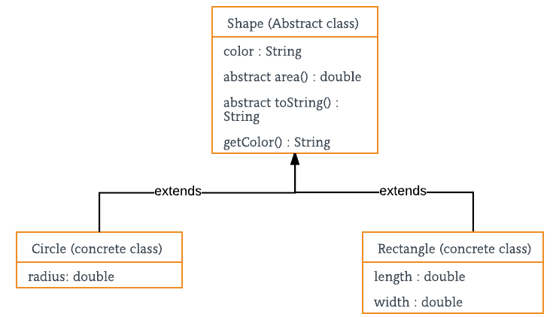

Slide 46
Interface-
The interface in Java is a mechanism to achieve abstraction. There can be only abstract methods in the Java interface, not the method body. It is used to achieve abstraction and multiple inheritance in Java. In other words, you can say that interfaces can have abstract methods and variables.
Interfaces specify what a class must do and not how. It is the blueprint of the behaviour.
Interface do not have constructor.
Represent behaviour as interface unless every sub-type of the class is guarantee to have that behaviour.
An Interface is about capabilities like a Player may be an interface and any class implementing Player must be able to (or must implement) move(). So it specifies a set of methods that the class has to implement.
If a class implements an interface and does not provide method bodies for all functions specified in the interface, then the class must be declared abstract.

Slide 47
interface Vehicle {
// all are the abstract methods.
void changeGear(int a);
void speedUp(int a);
void applyBrakes(int a);
}
class Bicycle implements Vehicle{
int speed;
int gear;
// to change gear
@Override
public void changeGear(int newGear){
gear = newGear;
}
// to increase speed
@Override
public void speedUp(int increment){
speed = speed + increment;
}
// to decrease speed
@Override
public void applyBrakes(int decrement){
speed = speed - decrement;
}
public void printStates() {
System.out.println("speed: " + speed
+ " gear: " + gear);
}
}
class Bike implements Vehicle {
int speed;
int gear;
// to change gear
@Override
public void changeGear(int newGear){
gear = newGear;
}
// to increase speed
@Override
public void speedUp(int increment){
speed = speed + increment;
}
// to decrease speed
@Override
public void applyBrakes(int decrement){
speed = speed - decrement;
}
public void printStates() {
System.out.println("speed: " + speed
+ " gear: " + gear);
}
}
class GFG {
public static void main (String[] args) {
// creating an instance of Bicycle
// doing some operations
Bicycle bicycle = new Bicycle();
bicycle.changeGear(2);
bicycle.speedUp(3);
bicycle.applyBrakes(1);
System.out.println("Bicycle present state :");
bicycle.printStates();
// creating instance of the bike.
Bike bike = new Bike();
bike.changeGear(1);
bike.speedUp(4);
bike.applyBrakes(3);
System.out.println("Bike present state :");
bike.printStates();
}
}

Slide 48
3. Encapsulation
refers to the bundling of data and methods that operate on that data within a single unit, which is called a class in Java. Encapsulation is a way of hiding the implementation details of a class from outside access and only exposing a public interface that can be used to interact with the class.

Slide 49
Technically, in encapsulation, the variables or the data in a class is hidden from any other class and can be accessed only through any member function of the class in which they are declared.
In encapsulation, the data in a class is hidden from other classes, which is similar to what data-hiding does. So, the terms “encapsulation” and “data-hiding” are used interchangeably.
Encapsulation can be achieved by declaring all the variables in a class as private and writing public methods in the class to set and get the values of the variables.

Slide 50
Eg-
class Encapsulate {
// private variables declared
// these can only be accessed by
// public methods of class
private String geekName;
private int geekRoll;
private int geekAge;
// get method for age to access
// private variable geekAge
public int getAge() { return geekAge; }
// get method for name to access
// private variable geekName
public String getName() { return geekName; }
// get method for roll to access
// private variable geekRoll
public int getRoll() { return geekRoll; }
// set method for age to access
// private variable geekage
public void setAge(int newAge) { geekAge = newAge; }
// set method for name to access
// private variable geekName
public void setName(String newName)
{
geekName = newName;
}
// set method for roll to access
// private variable geekRoll
public void setRoll(int newRoll) { geekRoll = newRoll; }
}
public class TestEncapsulation {
public static void main(String[] args)
{
Encapsulate obj = new Encapsulate();
// setting values of the variables
obj.setName("Harsh");
obj.setAge(19);
obj.setRoll(51);
// Displaying values of the variables
System.out.println("Geek's name: " + obj.getName());
System.out.println("Geek's age: " + obj.getAge());
System.out.println("Geek's roll: " + obj.getRoll());
// Direct access of geekRoll is not possible
// due to encapsulation
// System.out.println("Geek's roll: " +
// obj.geekName);
}
}

Slide 51
4. Polymorphism
The word polymorphism means having many forms. In simple words, we can define polymorphism as the ability of a message to be displayed in more than one form.

Slide 52
Eg-
A person at the same time can have different characteristics. Like a man at the same time is a father, a husband, an employee. So the same person possesses different behavior in different situations. This is called polymorphism.
Polymorphism is considered one of the important features of Object-Oriented Programming. Polymorphism allows us to perform a single action in different ways. In other words, polymorphism allows you to define one interface and have multiple implementations. The word “poly” means many and “morphs” means forms, So it means many forms.

Slide 53
Types of polymorphism
In Java polymorphism is mainly divided into two types:
Compile-time Polymorphism
Runtime Polymorphism

Slide 54
Type 1: Compile-time polymorphism
It is also known as static polymorphism. This type of polymorphism is achieved by function overloading or operator overloading.
What is method overloading?
Method Overloading: When there are multiple functions with the same name but different parameters then these functions are said to be overloaded. Functions can be overloaded by changes in the number of arguments or/and a change in the type of arguments.

Slide 55
class Helper {
// Method with 2 integer parameters
static int Multiply(int a, int b)
{
// Returns product of integer numbers
return a * b;
}
// Method 2
// With same name but with 2 double parameters
static double Multiply(double a, double b)
{
// Returns product of double numbers
return a * b;
}
}
// Class 2
// Main class
class GFG {
// Main driver method
public static void main(String[] args)
{
// Calling method by passing
// input as in arguments
System.out.println(Helper.Multiply(2, 4));
System.out.println(Helper.Multiply(5.5, 6.3));
}
}

Slide 56
Type 2: Runtime polymorphism
It is also known as Dynamic Method Dispatch. It is a process in which a function call to the overridden method is resolved at Runtime. This type of polymorphism is achieved by Method Overriding. Method overriding, on the other hand, occurs when a derived class has a definition for one of the member functions of the base class. That base function is said to be overridden.

Slide 57
class Parent {
// Method of parent class
void Print()
{
// Print statement
System.out.println("parent class");
}
}
// Class 2
// Helper class
class subclass1 extends Parent {
// Method
void Print() { System.out.println("subclass1"); }
}
// Class 3
// Helper class
class subclass2 extends Parent {
// Method
void Print()
{
// Print statement
System.out.println("subclass2");
}
}
// Class 4
// Main class
class GFG {
// Main driver method
public static void main(String[] args)
{
// Creating object of class 1
Parent a;
// Now we will be calling print methods
// inside main() method
a = new subclass1();
a.Print();
a = new subclass2();
a.Print();
}
}

